Slide 1
What does infectious disease look like in the mind?
Nick Michalak
Josh Ackerman

Slide 2
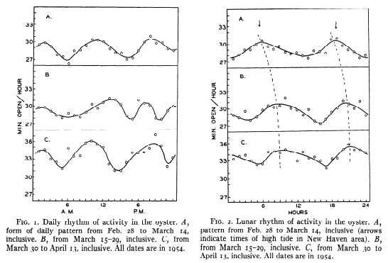
Oysters use the lunar cycle to predict high tide
Brown, 1954;
Schaller & Neuberg, 2012
Notes:
This is because oysters evolved in environment in which it was efficient to calibrate their valve behavior to the lunar cycle. Gravitational shifts were a reliable cue to high tide. To oysters, high tide ‘looks’ like subtle changes in gravity.

Slide 3
Infectious disease is like high tide: an enduring, predictable feature of the environment.
Schaller & Murray, 2015
Notes:
Disease-causing parasites--bacteria, viruses, helminths--are a lot like high tide: they are and have been an enduring, predictable feature of the environment for most if not all organisms for many millions of years.

Slide 4
Biological systems are ‘designed’ to detect and reduce pathogen threats.
Nesse, 2005; Schaller & Murray, 2015
Notes:
What emerges from this pressure over millions of years of mutation and selection are systems ‘designed’ to detect the presence of a pathogen that poses some fitness-threat and respond in a way that reduces the threat.

Slide 5
The social and physical world is rich with information that guides biologically and socially functional behavior.
Gibson,1979; McArthur & Baron,1983
Notes:
Because many organisms can’t detect pathogen threats directly, they have to rely on perceptible cues present in other organisms and the environment. In general, the social and physical world is rich with information that guides biologically and socially functional behavior.

Slide 6
Social creatures use cues to infer pathogen infection in members of their own species.
Behringer, Butler, & Shields, 2006; Curtis, 2014; Kiesecker, Skelly, Beard, & Preisser, 1999; Krause, & Godin, 1994
Notes:
promise I’ll start talking about people in a few minutes, but I have a few more non-human animal examples. The point here is that a variety of organisms detect and respond to disease cues in members of their own species. There’s evidence of this in Caribbean spiny lobsters, bullfrog tadpoles, and killifish. For example, killifish tend to avoid shoals with other fish infected with trematode worms. In one experiment, researchers injected the fish with black dye to make spots that imitate the worm infection, and the fish avoided shoals with these sham-infected fish. This suggests killifish are using visual cues to infer infection in other fish. The takeaway here is that social creatures are using cues present in members of their own species to infer who is sick and who’s healthy.

Slide 7
People have a highly-developed visual skill for face perception.
Bentin, Allison, Puce, Perez, & McCarthy, 1996; Birmingham, Bischof, & Kingstone, 2009; Haxby, Hoffman, & Gobbini, 2000; Kanwisher, McDermott, & Chun, 1997
Notes:
In a broad sense, people do the same thing. And people are probably relying more strongly on visual cues of infection, especially cues that are present in the face. I don’t mean people can’t or don’t use other cues to determine who’s sick. They’re just so good at using facial cues. Research suggests that not only do people very quickly infer social traits from faces, but they tend to devote more attention and processing to faces relative to other objects, and rapid facial encoding correlates with neural activation in regions associated with high-level vision (i.e. recognizing or identifying objects vs. analyzing their structural details). SO humans care about faces.

Slide 8
Mumps
Measles
23/25 (92%) of most deadly infectious diseases cause symptoms visible in the face.
Ryan, Oaten, Stevenson, & Case, 2012; Wolfe, Panosian, & Diamond, 2007
Yellow Fever
Notes:
Most importantly, of the 25 most deadly infectious diseases (currently and historically), 23 of them cause symptoms that are visible in the face: rashes, bleeding under the skin, swelling in the face and neck, jaundice, changes in eye color, etc. So, not only are people very keen at looking at and extracting meaning from faces, but faces are extremely relevant sources of information about infectious disease.

Slide 9
What does an infected person look like?
Notes:
Now, I promised you this was a talk about mental representations of disease. Here we go. I think the best way to introduce this phenomenon is to have you make one yourself.
Just take a second and think to yourself, what comes to mind when you picture someone who might get you sick? My prediction is that, whoever or whatever you’re imagining right now, the features that you see are not exhaustive diagnostic cues of infectious disease. That’s because harmful pathogens and the symptoms they cause in people are practically infinite; it would be impossible for you to develop a truly accurate portrait of what all disease looks like.
One potential evolutionary solution to this problem is to cut corners with your mental prototype; ‘play it safe’ and assume that anyone who looks or acts kinda’ strange is going to get you sick.

Slide 10
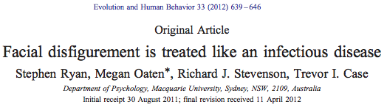
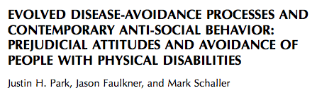
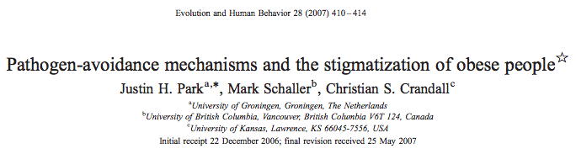
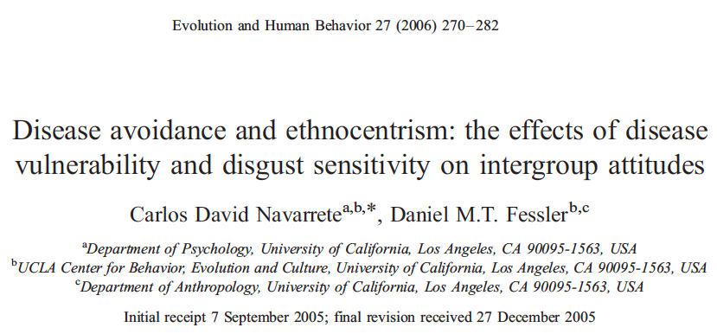
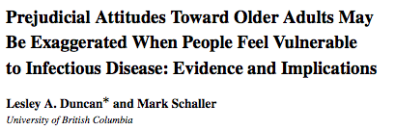
Notes:
This assumption has fueled a growing body of literature suggesting that whether people are chronically or incidentally threatened by infectious disease, they tend to respond to people with strange or atypical features as if these individuals are infected. For example, one series of experiments demonstrated that disease threat can increase attention toward disfigured faces; other studies have linked disease threat to xenophobia and anti-fat attitudes.

Slide 11
People respond to atypical features as if these features cue infectious disease
Schaller & Murray, 2015
Notes:
So, people seem to respond to these atypical features as if they cue infectious disease

Slide 12
Mental representations of faces share processes with direct facial perception.
Birmingham, Bischof, & Kingstone, 2009; Ishai, Haxby, & Ungerleider, 2002; Mechelli, Price, Friston, & Ishai, 2004; O’Craven & Kanwisher, 2000
Notes:
Research suggests that the same mental processes involved in direct facial perception share processes with mental representation. It’s possible that mental representations of infected people possess these same features associated with disease threat; however, it doesn’t follow that people’s mental representations of infectious disease must comprise these atypical features.

Slide 13
Think of a THREATENING person
Notes:
To see what I mean, imagine a threatening person. Do you have it? Ok, how many of you imagined a toddler with a handgun? My guess is no one. Yet, if you were lucky enough to meet this kid in this moment, you’d feel threatened, to say the least.
So, threatening people come in all shapes and sizes, but our mental images of threatening people must be limited.
The same is likely true for mental images of infected people. But we don’t know which facial features naturally emerge when people think about someone who is infected.

Slide 14
Research questions
What does an infected person look like in the minds of participants?
Does this mental image have generally negative features, or are its features specific to pathogen threats?
Are these features more extreme for participants who perceive themselves to be more vulnerable to pathogen threats?
Do these images motivate adaptive (intentional) behavior?

Slide 15
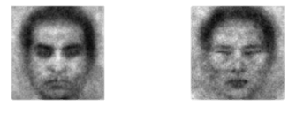
Reverse correlation image classification task: used to estimate internal representations of a target category
Ratner, Dotsch, Wigboldus, van Knippenberg, & Amodio, 2014
Dotsch & Todorov, 2012
Moroccan man
Chinese man
Dotsch, Wigboldus, Langner, & van Knippenberg, 2008
Karremans, Dotsch, & Coreille, 2011
Notes:
To begin to answer these questions, we used a reverse correlation image classification task. The goal of this task is estimate internal representations of a target category. We use the computer to generate pairs of faces with random variations in their facial features and then we have participants select which faces best represent the target category.
This approach is data-driven in that it allows participants to search for patterns they deem relevant for some mental prototype, and the stimuli make very few assumptions about which features matter for that prototype.

Slide 16
Image generation phase
Image rating phase
Create classification images from participant selections
Create stimuli
pairs
Participants select from stimuli pairs
New participants rate the classification image features
Notes:
A typical reverse correlation task has about 4 basic steps. First, we select a base image and create stimuli. Participants select which faces best represents some target category. We use their selection to create mental representations, and, finally, we have a separate group of participants rate the images. You can think of these steps as making up two phases: an image generation phase and an image rating phase.

Slide 17
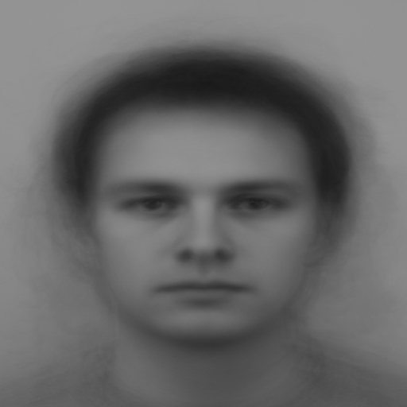
+/- Random Noise
Base image
Notes:
Every pair of faces is the product of a base image overlain with a random noise mask. This image is a grey scale composite of every male face in the Chicago Face Database.

Slide 18
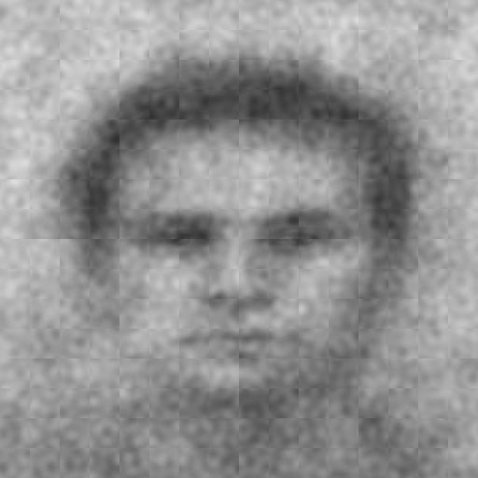
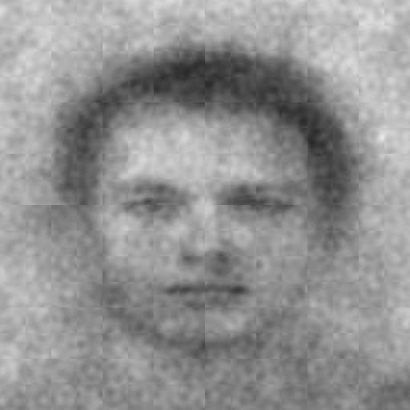
Which face looks more [insert category]?
Noise
added
Noise subtracted
Notes:
Each pair comprises the base face with the noise mask subtracted and added. On the left, noise is added and on the right noise is subtracted. We of course randomize the position of each face in the selection task.

Slide 19
Which face looks more germy?
Notes:
We used germy as our target category.

Slide 20
Study 1: Image generation phase
Not pre-registered
94 Michigan undergraduates completed 400 trials of germy reverse correlation task
Individual difference measures
Perceived Vulnerability to Disease Questionnaire (Duncan, Schaller, & Park, 2009)
Belief in a Dangerous World (Altemeyer, 1988)
Three Domain Disgust Scale (Tybur, Lieberman, & Griskevicius, 2009)
Included all who completed the study
80% power to detect r = .28

Slide 21
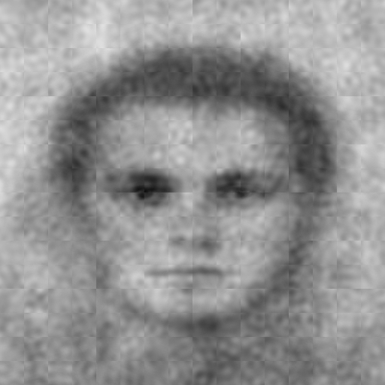
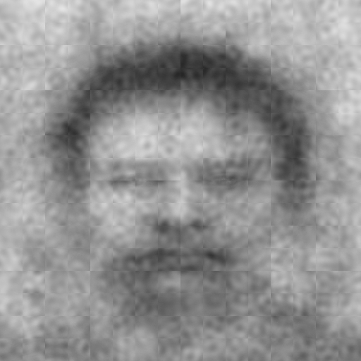
anti-Germy
Germy
Generated using rcicr (Dotsch, 2016)
Michigan undergraduates (N = 94)

Slide 22
Study 1: Image rating phase
Pre-registered (aspredicted.org)
TurkPrime (Litman, Robinson, & Abberbock, 2016)
Randomly assigned to rate one face set
138 (23 excluded) rated the anti-Germy faces
133 (37 excluded) rated the Germy faces
80% power to detect d = .34
Inclusion
completed survey
wrote, "I read and understand these trait definitions.” (Hauser & Schwarz, 2015)

Slide 23
Study 1: Image ratings phase
Physical/external ratings
0 = ‘Not at all’ to 8 = ‘Extremely’
Character/internal ratings
0 = ‘Not at all’ to 8 = ‘Extremely’
Disfigured
Heavy
Old
Foreign
Germy
Violent
Arrogant
Incompetent
Trustworthy
Notes:
We measured features that were most relevant to the disease threat or behavioral immune system literature I cited earlier. We predicted these mental images to be rated as more ...
In contrast, we didn't expect the faces to be rated more arrogant or violent.

Slide 24
Study 1: Image ratings phase
Intentions to avoid
0 = ‘Not at all’ to 8 = ‘Extremely’
‘If you were to meet in real life...
‘…how much would you want to avoid physical contact with this person?’
‘...how willing would you be to stand near this person?’
Notes:
We also measured behavioral intentions to avoid the people depicted in the images

Slide 25
ci
anti-Germy
Germy
Trustworthy
Incompetent
Arrogant
Violent
Foreign
Old
Heavy
Disfigured
Germy
Not at all
1
2
3
4
5
6
7
Extremely
(0)
(8)
Rating
Error bars = 95% confidence intervals
Notes:
Here are the results. As predicted, the germy face was rated as more germy, disfigured, heavy, old and foreign. In contrast, they were only weakly rated more violent, arrogant and incompetent. Also, as predicted, they were rated as less trustwrothy.

Slide 26
Germy = 1
anti-Germy = -1
c
Avoidance Index
.383, 95% CI [.066, .678]
Total effect
Latent variable
‘Want to avoid’
‘Willing to stand near’
(reverse-coded)
Disfigured
Rating
a₁
b₁
Germy = 1
anti-Germy = -1
c’
Avoidance Index
.189, 95% CI [-.072, .520]
Direct effect
Disfigured_{Indirect} = .194, 95% CI [.096, .319]
Indirect effect
Model run using lavaan (Rosseel, 2012)
Notes:
Also as predicted, people reported greater intentions to avoid the germy person, and as disfigured ratings increased, so did their intentions to avoid the germy person, as indexed by the indirect effect. This is an example analysis, and I'd like to talk later about how you all think I can test indirect effects with more ratings in an elegant or parsimonious way.

Slide 27
Trait-level pathogen avoidance (e.g. disgust, germ aversion) may increase sensitivity to infectious disease cues.
Tybur & Lieberman, 2016; Wang, Michalak, & Ackerman, In press
Notes:
We predicted that people who are chronically concerned about infectious disease threat might generate mental images with more exaggerated features, so we measured trait-level pathogen avoidance.

Slide 28
Chronic physical safety motivations may increase sensitivity to violence cues (e.g. anger).
e.g. Maner, Kenrick, Becker, et al., 2005
Notes:
It's possible that any individual differences in threat sensitivity or anxiety might increase sensitivity to threatening cues, so we also measured chronic physical safety motivations

Slide 29
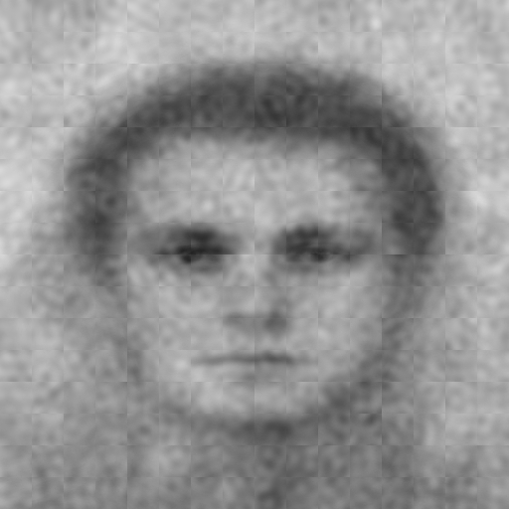
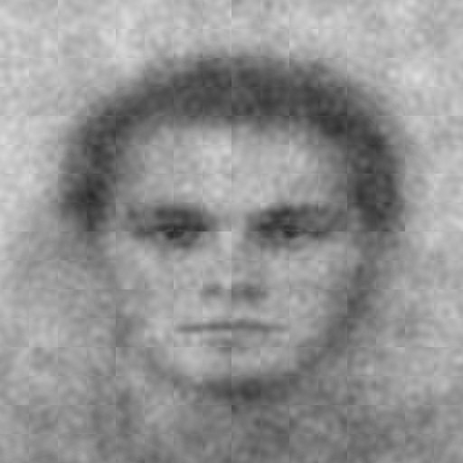
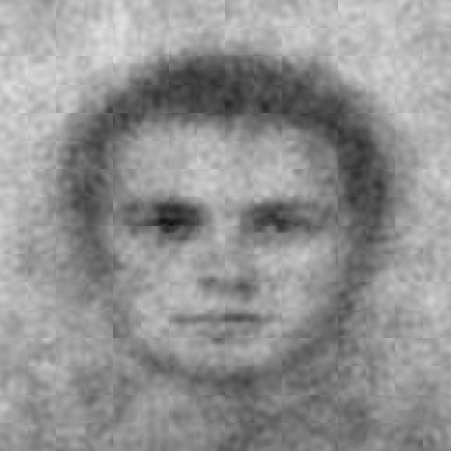
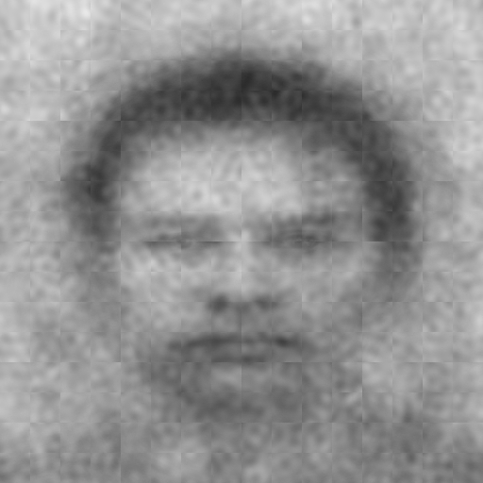
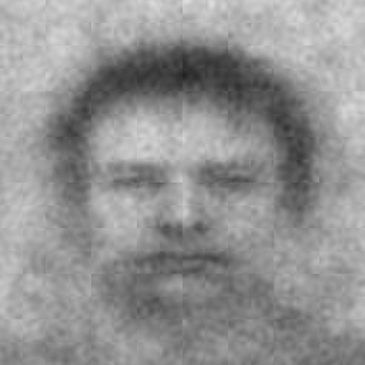
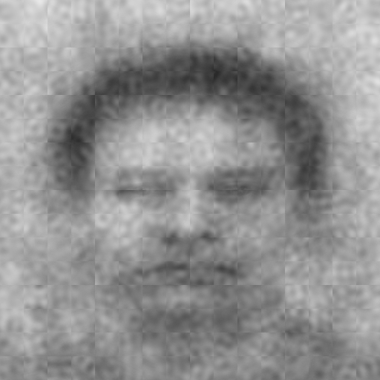
Image generator Germ Aversion percentiles
anti-Germy
Germy
0-33%
33-66%
66-99%
Notes:
We could not measure all of these features for every single persons mental images, so we calculated 33rd percentiles of germ aversion scores and used these groups to create mental images.

Slide 30
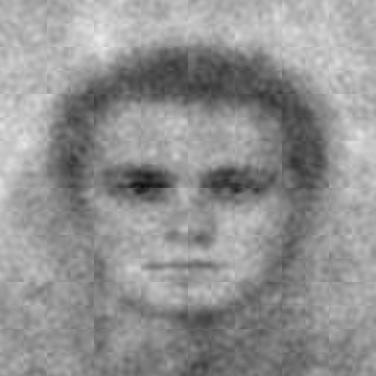
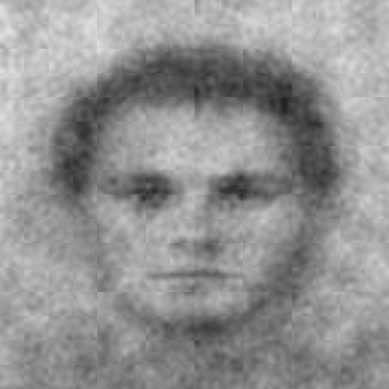
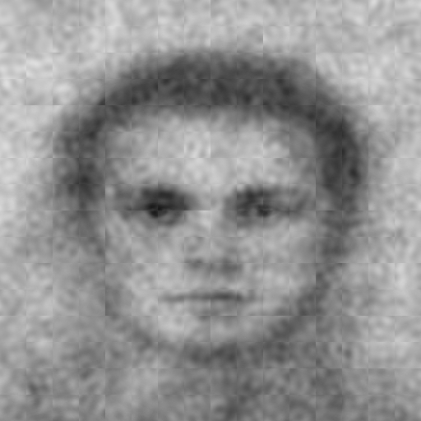
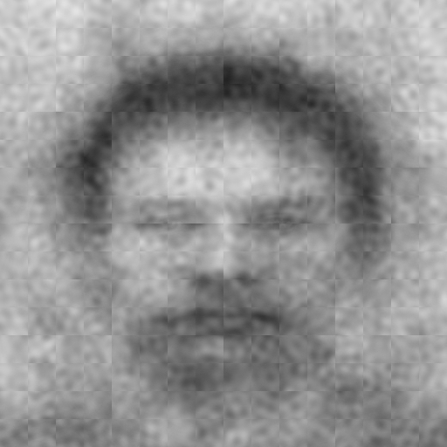
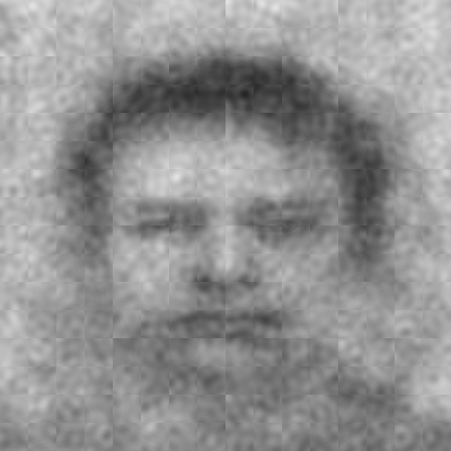
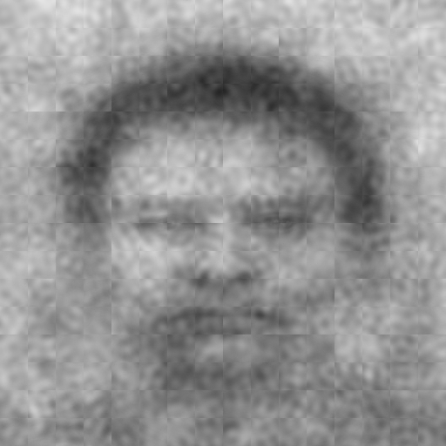
Image generator Belief in a Dangerous World percentiles
anti-Germy
Germy
0-33%
33-66%
66-99%
Notes:
We did the same for belief in a dangerous world.

Slide 31
Error bars = 95% confidence intervals
ci
anti-Germy
Germy
Belief in a Dangerous World
Germ Aversion
Extremely (8)
7
6
5
Germy
4
3
2
1
Not at all (0)
Low (0-33%)
Moderate (33-66%)
High (66-99%)
Low (0-33%)
Moderate (33-66%)
High (66-99%)
Percentile of Individual Difference
Individual difference (BDW vs. GA) x CI (Germy vs. anti-Germy) x Linear Trend, t(266.91) = -3.93, p = .0001078
Notes:
We predicted that as germ aversion increased, so would germy ratings, and this linear trend should be stronger than that for belief in a dangerous world. Here are the comparison ratings for belief in a dangerous world. As you can see, there's not much of a linear trend.
In contrast, here are the comparison ratings for germ aversion. As you can see, we found evidence for our predicted linear trend.

Slide 32
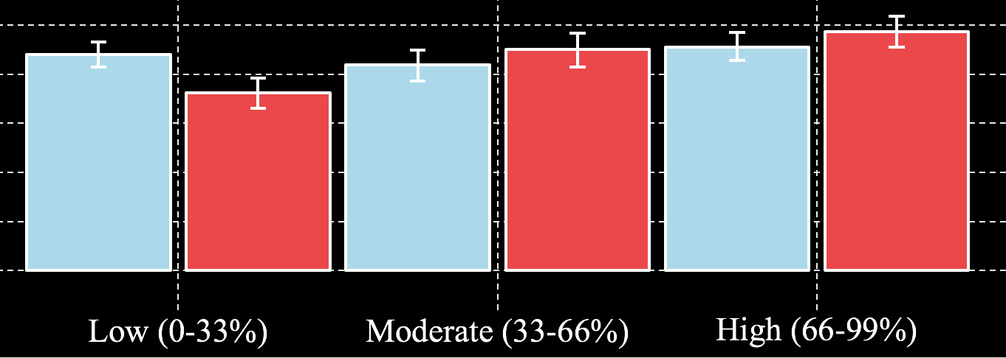
Error bars = 95% confidence intervals
ci
ci
anti-Germy
Germy
Individual difference (BDW vs. GA) x CI (Germy vs. anti-Germy) x Linear Trend, t(266.91) = -3.93, p = .0001078
Notes:
I'm religious opposed to truncating graphs, so I've zoomed in so you can see the effect.

Slide 33
Study 1: take this with you
anti-Germy
Germy
Notes:
So, to wrap up study 1, we estimated a mental image of an infected person. We used germy as our target category.

Slide 34
Study 1: take this with you
Appears more germy, disfigured, heavy, old, incompetent, and foreign
Appears less trustworthy
Weak evidence for arrogant and violent appearance
Trait-level pathogen avoidance exaggerates these features
These features had indirect influence on intentions to avoid

Slide 35
Study 2: Goals
Replicate germy mental image
Contrast germy mental image with another threat: violence
Measure more features
Notes:
We had 3 main goals for our next study...

Slide 36
Study 2: Image generation phase
Pregistered (aspredicted.org)
TurkPrime (Litman, Robinson, & Abberbock, 2016)
Randomly assigned to one trait:
98 (107 excluded) selected the more germy face
102 (90 excluded) selected the more violent face
Individual difference measures
Perceived Vulnerability to Disease Questionnaire (Duncan, Schaller, & Park, 2009)
Self-protection (Fundamental Social Motives; Neel, Kenrick, White, & Neuberg, 2015)
Inclusion
completed survey
wrote, "I understand this definition of violent and that A picks the left image and L picks the right image.” (Hauser & Schwarz, 2015)
80% power to detect r = .27 (per face type)

Slide 37
In this study, we defined germy for participants:
germy: full of germs; germ infested; appearing either sick or contaminated

Slide 38
In this study, we defined violent for participants:
violent: prone to commit acts of violence; uses physical force intended to hurt, damage, or kill someone or something

Slide 39
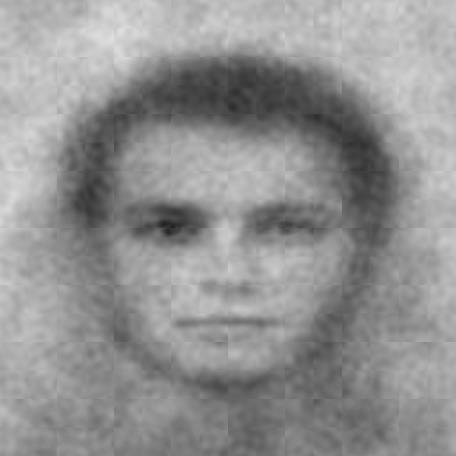
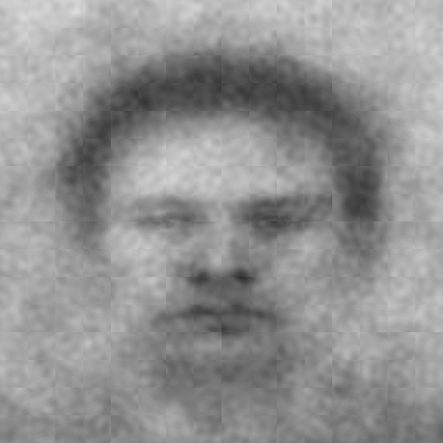
anti-CI
CI
Study 1
N = 94
Germy
(UM)
Study 2
n = 102
Germy
(MTurk)
Generated using rcicr (Dotsch, 2016)
Notes:
Here are the results from study 2 compared to study 1. I like to think of this as a qualitative replication.

Slide 40
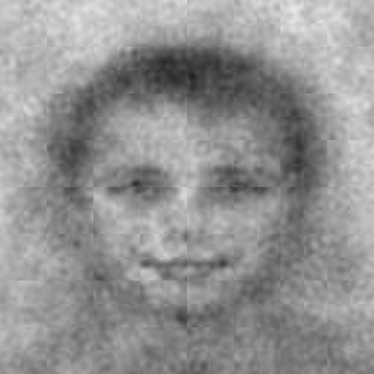
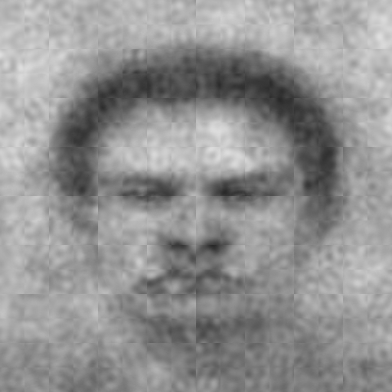
anti-CI
CI
Violent
n = 98
Germy
n = 102
Generated using rcicr (Dotsch, 2016)
Notes:
And here's our comparison mental images for violent. They look like orks from lord of the rings.

Slide 41
Study 2: Image rating phase
Pre-registered (aspredicted.org)
TurkPrime (Litman, Robinson, & Abberbock, 2016)
Inclusion
completed survey
wrote, "I read and understand these trait definitions.” (Hauser & Schwarz, 2015)
Randomly assigned to rate one face set:
126 (41 excluded) rated the anti-Germy faces
127(32 excluded) rated the Germy faces
126 (39 excluded) rated the anti-Violent faces
128 (37 excluded) rated the Violent faces
80% power to detect main effects and interactions, d = .25

Slide 42
Study 2: Image rating phase
Physical/external ratings
0 = ‘Not at all’ to 8 = ‘Extremely’
Character/internal ratings
0 = ‘Not at all’ to 8 = ‘Extremely’
Disfigured
Heavy
Old
Foreign
Muscular
Masculine
Violent
Germy
Dominant
Arrogant
Incompetent
Angry
Nauseous
Notes:
We measured the the same features from study 1 except for trustworthy. Sorry Dave. We also measured features we thought would be more relevant for violent compared to germy. We expected the germy faces to be rated more ...
In contrast, we expected the violent phases to be rated more ...

Slide 43
Study 1: Image ratings phase
Intentions to avoid
0 = ‘Not at all’ to 8 = ‘Extremely’
‘If you were to meet in real life...
‘…how much would you want to avoid physical contact with this person?’
‘...how willing would you be to stand near this person?’
Notes:
We also measured behavioral intentions to avoid the people depicted in the images

Slide 44
(-1)
(1)
(-1)
(1)
Image Trait
anti-CI
CI
Trait
Germy
Violent
Angry
Dominant
Violent
Masculine
Muscular
Nauseous
Incompetent
Foreign
Old
Heavy
Disfigured
Germy
Not at all
1
2
3
4
5
6
7
Extremely
Not at all
1
2
3
4
5
6
7
Extremely
(0)
(8)
(0)
(8)
Mean Rating
Error bars = 95% confidence intervals
Notes:
As predicted, the germy faces were rated more ...
In contrast, they were not rated much more masculine, muscular, or dominant. However, to our surprise, they were rated more violent and angry.
Also to our surprise, the violent faces were also rated more ...
However, they were rated way more muscular, masculine, violent, dominant, and angry than the germy faces.

Slide 45
CI = 1
anti-CI = -1
c
Avoidance Index
.461, 95% CI [.281, .629]
Total effect
Latent variable
‘Want to avoid’
‘Willing to stand near’
(reverse-coded)
Violent = 1
Germy = -1
Violent
Rating
a₁
b₁
CI = 1
anti-CI = -1
c’
Avoidance Index
.264, 95% CI [.070, .448]
Direct effect
IMM = .082, 95% CI [.038, .138]
Index of moderated mediation (Hayes, 2015)
Model run using lavaan (Rosseel, 2012)
Notes:
As predicted, people reported intentions to avoid the germy and violent people.
Also as predicted, as violent ratings increased, so did behavioral intentions to avoid, but this indirect effect depended on the whether the face was germy or violent.
This is indexed by ...
As you saw on the previous slide, the germy faces was rated as more violent, but the violent phases was rated as extremely violent, which is driving this effect.
This is one of many possible analyses, and I'd like to hear your thoughts about other tests later.

Slide 46
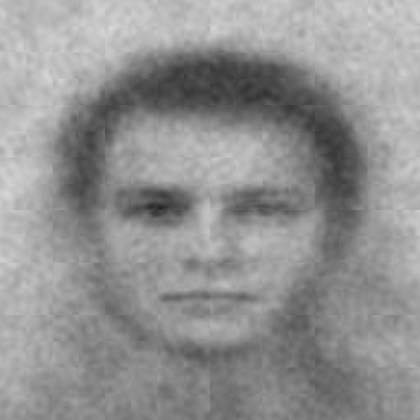
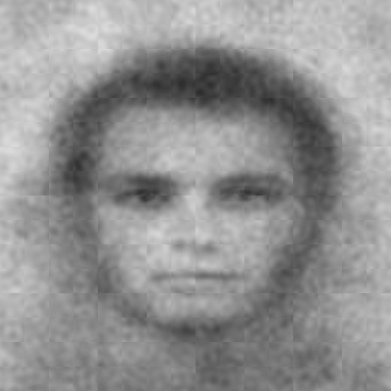
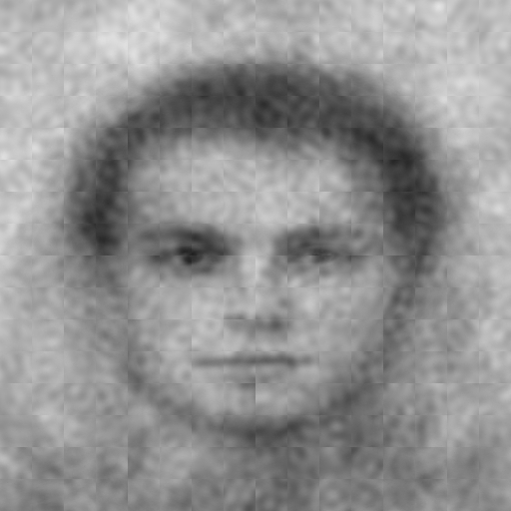
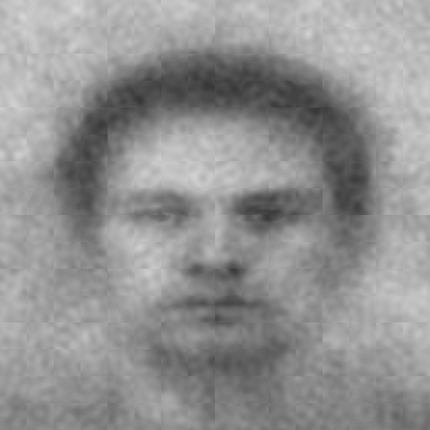
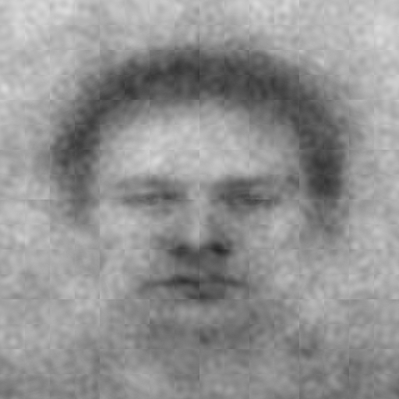
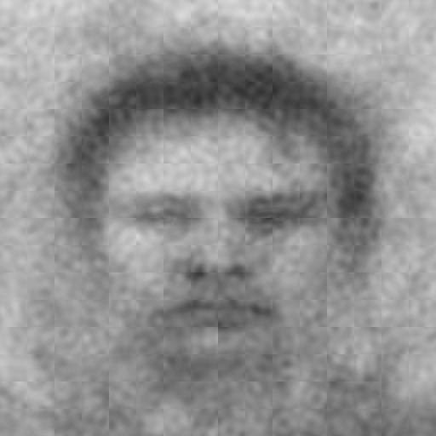
Image generator Perceived Infectability percentiles
anti-Germy
Germy
0-33%
33-66%
66-99%
Notes:
Like in study one, we created mental images based on percentiles of ...
In this case, we used

Slide 47
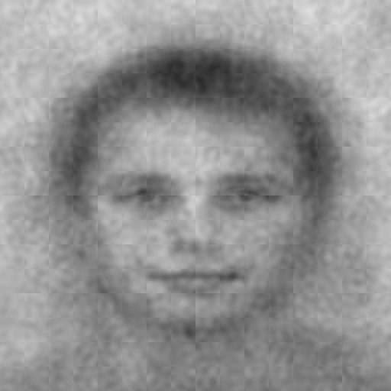
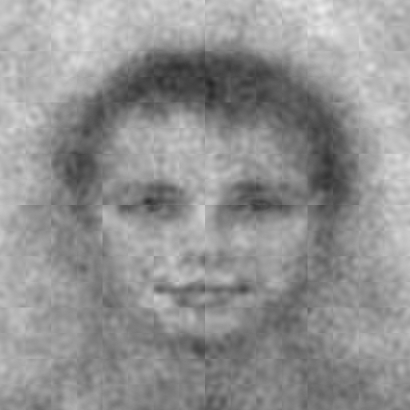
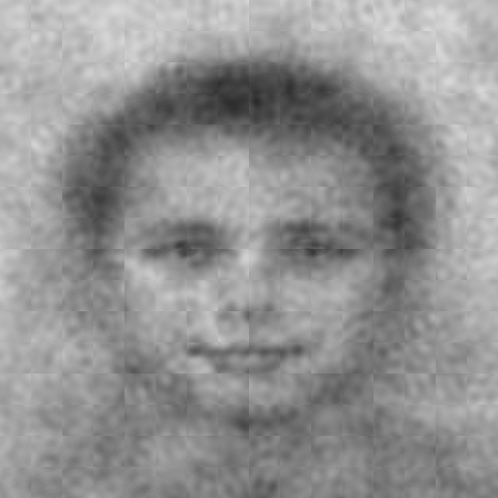
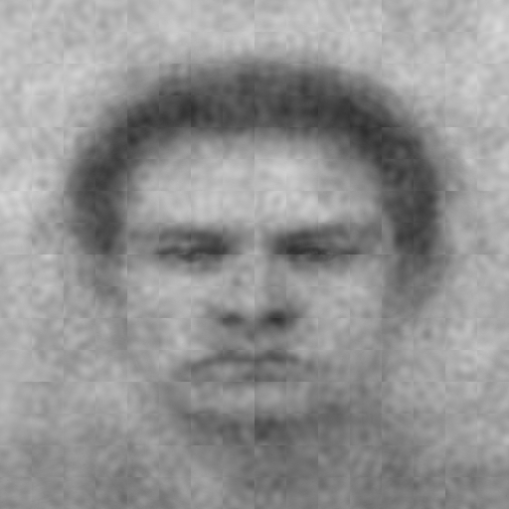
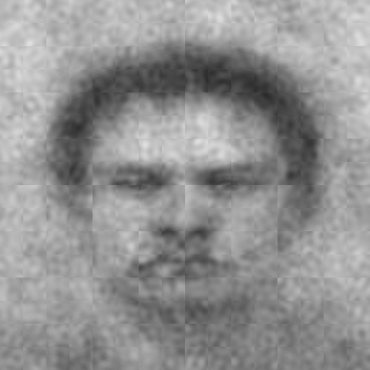
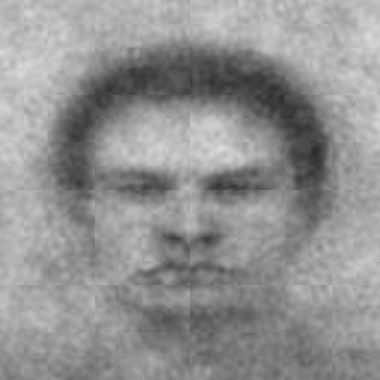
Image generator Perceived Infectability percentiles
anti-Violent
Violent
0-33%
33-66%
66-99%
Notes:
One advantage to these data is the violent phase comparison. Even though we did measure chronic physical safety motivations, we can use the violent mental images to test our prediction that trait-level pathogen avoidance will exaggerate germy features in both traits, germy and violent.

Slide 48
(-1)
(1)
(-1)
(1)
CI
anti-CI
CI
Germy
Violent
Extremely (8)
7
6
5
Germy
4
3
2
1
Not at all (0)
Low (0-33%)
Moderate (33-66%)
High (66-99%)
Low (0-33%)
Moderate (33-66%)
High (66-99%)
Percentiles of Individual Difference
CI (anti-CI vs. CI) x Trait (Germy vs. Violent) x Linear Trend, t(419.68) = -3.37, p = .000825
Notes:
Much like in study we, we found evidence for a linear trend for the trait-level pathogen avoidance such that increasing levels of perceived infectability lead to germier looking germy images but not germier violent images.

Slide 49
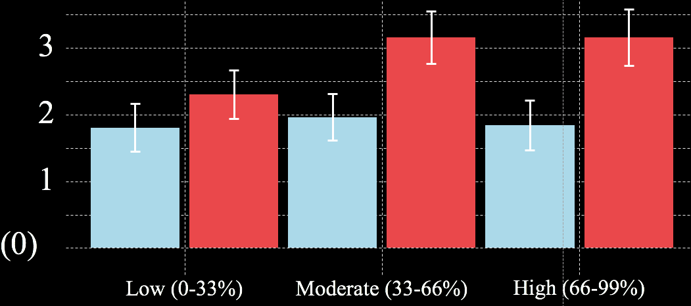
(-1)
(1)
CI
Germy
CI (anti-CI vs. CI) x Trait (Germy vs. Violent) x Linear Trend, t(419.68) = -3.37, p = .000825
Notes:
Much like in study we, we found evidence for a linear trend for the trait-level pathogen avoidance such that increasing levels of perceived infectability lead to germier looking germy images but not germier violent images.

Slide 50
anti-CI
CI
Study 1
N = 94
Germy
(UM)
Study 2
n = 102
Germy
(MTurk)

Slide 51
The atypical features associated with infectious disease threat and avoidance are reflected in the germy mental image

Slide 52
We found some evidence that these features have an indirect effect on avoidance intentions

Slide 53
We found some evidence that trait-level pathogen avoidance exaggerates (or attenuates) these features

Slide 54
Surprises
Germy mental images appeared angry and violent
Weak evidence for dominant and foreign appearance
Violent mental images shared all features with the germy mental images
Physical safety motivation didn’t exaggerate (or attenuate) features in either mental image

Slide 55
Evolutionary Social Psychology Lab
Lab mates
Iris Wang, co-Data maid
‘Badass’ Yuching Lin
Oliver Sng
(pronounced All-i-ver)
Reseach assistants
Emily Jones
Isabel Osgood
Tyler Aman
Megan Mulhinch
Emily Dyke
Shyryn Borgol
Michelle Conklin
Advisor
(Tenured) Professor Josh Ackerman

Slide 56
Thank you
Download these slides: https://osf.io/gb5xj/

Slide 57
Are there any tests you’d like to see conducted on these data? Why?
Would you like to see more features measured? For which mental image? Why?
Would you like to see a different mental image to compare to the germy image? Why?
Questions for you

Slide 58
(-1)
(1)
(-1)
(1)
Trait
Germy
Violent
Image Trait
Angry
Dominant
Violent
Masculine
Muscular
Nauseous
Incompetent
Foreign
Old
Heavy
Disfigured
Germy
-2.0
-1.8
-1.6
-1.4
-1.2
-1.0
-0.8
-0.6
-0.4
-0.2
0.0
0.2
0.4
0.6
0.8
1.0
1.2
1.4
1.6
1.8
2.0
Standardized Mean Difference
Error bars = 95% confidence intervals

Slide 59
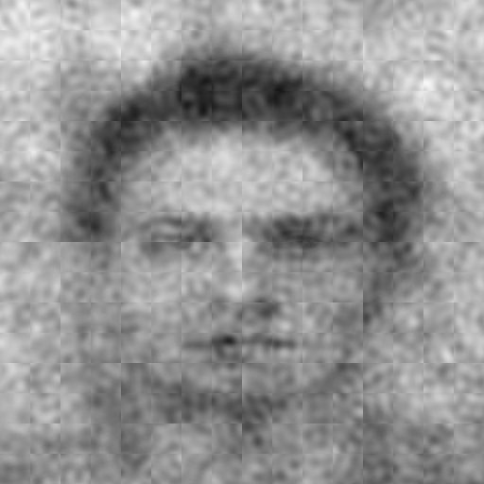
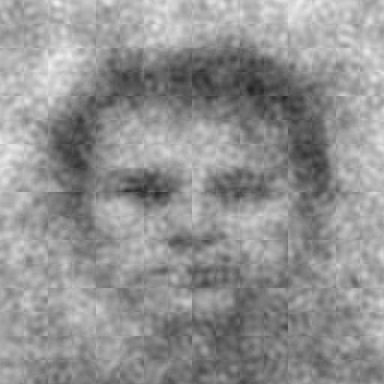
What do random selections look like?
anti-CI
CI

